Slide 1
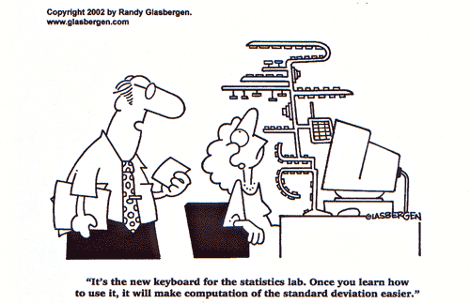
Spread Measures
Part 5
Dr. Abolfazl Saghafi
Assistant Professor of Statistics & Data Science
Data Science Program Director

Slide 2
Common Spread Measures
X
Variable of interest
Spread Measures provide a value of dispersion, deviation or variability. Some common spread measures are
Population
of size N
Sample of size n
Range
Inner-quartile Range (IQR)
Variance (population/sample)
Standard Deviation (population/sample)
Coefficient of Variation (CV)
X1, X2, …, XN
n <= N
Observation 1 2 3 … n
Data values x₁ x₂ x₃ … xn
Skewness is a Shape Measure that provides a value of symmetry/asymmetry.
Observation 1 2 3 4 5
Data values 5 7 3 9 7
Example
Notes:
You are interested! in assessing the behavior of a random phenomenon in a large group of people. It could be their height, shoe size, annual expenditure on gas, daily calories, etc. The population size (N) is huge and it’s not feasible to study the whole population. Therefore, you take a small sample of size n and study that instead. We show the sample measurements as x₁, x₂, x₃, …, $x_{n}$
In this session we focus on measures of spread in the sample and population. Afterall, you should know how your variable of interest is spread. The most common spread measures are mentioned here which we study in details here

Slide 3
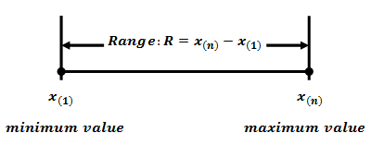
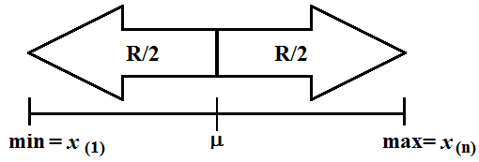
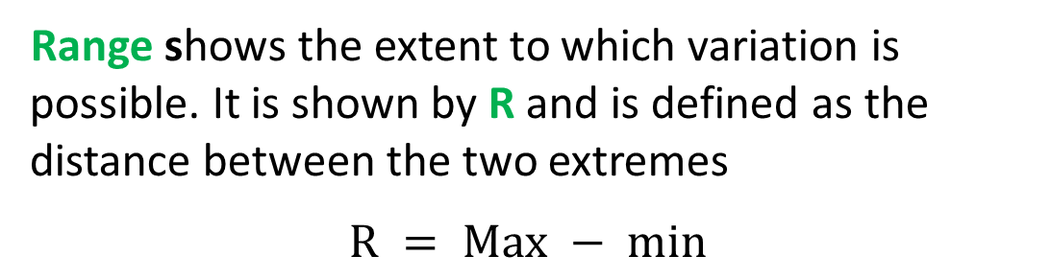
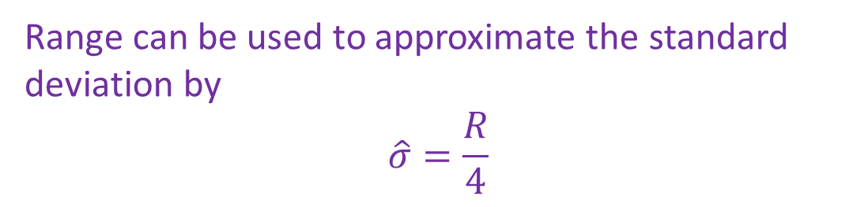
Range
Observation 1 2 3 4 5
Data values 5 7 3 9 7
Range = 6
Range shows the extent to which variation is possible. It is shown by R and is defined as the distance between the two extremes
$$R = Max − min⁡$$
Range can be used to approximate the standard deviation by
$$\hat{σ}=\frac{R}{4}$$
Notes:
You’ll see later that computing the standard deviation is tedious, here we have a quick approximation which is super easy to compute

Slide 4
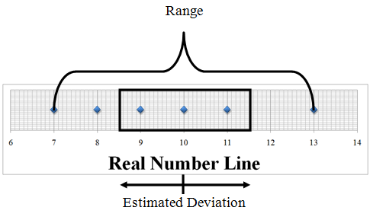
Example
Given the following sample data:
7, 9, 10, 11, 13
What is the range of variation?
Use the range to approximate the standard deviation.
Notes:
R = Max – min = 13 – 7 = 6
Approximation for standard deviation is 6 / 4 = 1.5

Slide 5
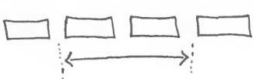

Inter-quartile Range (IQR)
Observation 1 2 3 4 5
Data values 5 7 3 9 7
IQR = 8 – 4 = 4
The idea is to divide the data into four equal groups (after sorting) and see haw far apart the extreme groups are
2 3 3 3 4 4 5 5 6 6 6 7 7 7 8 9
Q1 = 3.5
Q3 = 7
IQR = 7 - 3.5 = 3.5
2 3 3 3 4 5 5 6 6 6 7 7 8
Q1 = 3
Q3 = 6.5
IQR = 6.5 - 3 = 3.5

Slide 6
Examples
Ex1. Find the IQR (n=10)
Ex2. Find the IQR (n=9)
62 63 64 64 70 72 76 77 81 81
63 64 64 70 72 76 77 81 81
Notes:
m=71, Q1=64, Q3=77, IQR=Q3-Q1=13
m=72, Q1=64, Q3=79, IQR=Q3-Q1=15

Slide 7
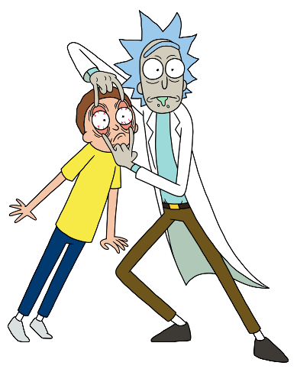

Variance
The SAMPLE variance is the squared mean deviation from SAMPLE mean. You will need SAMPLE data to compute it
The Population variance is the squared mean deviation from population mean. You will need access to ALL population data to compute it
sample
mean
Sum is over sample
$$σ^{2}=\frac{1}{N}\sum_{i=1}^{N}{{\left(X_{i}−μ\right)}^{2}}$$
shown by
remember
Which one do we compute using the following numbers?
shown by
or
Var(X)
population mean
Observation 1 2 3 4 5
Data values 5 7 3 9 7
Average and Sum is over
population
5.2
Notes:
For these numbers we compute SAMPLE variance since these are sample data. First you need to compute the sample mean which simply is the average. It will be $\overline{x}=6.2$. Then we have
$$s^{2}=\frac{1}{4}\left({\left(5−6.2\right)}^{2}+{\left(7−6.2\right)}^{2}+{\left(3−6.2\right)}^{2}+{\left(9−6.2\right)}^{2}+{\left(7−6.2\right)}^{2}\right)=5.2$$

Slide 8
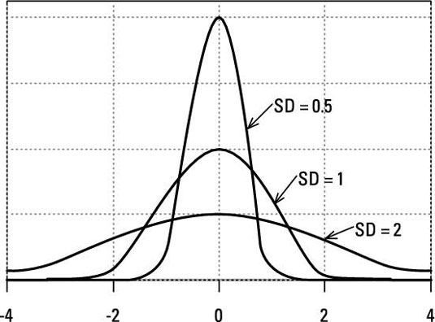
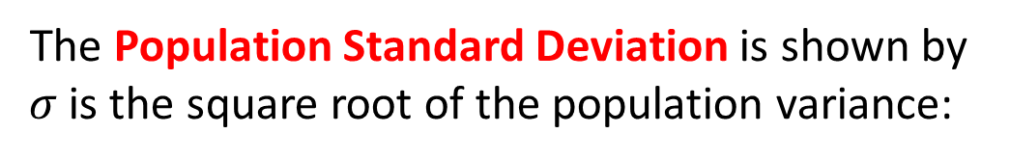
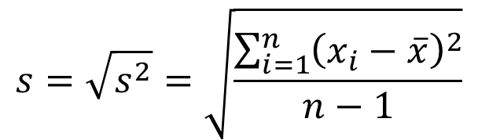
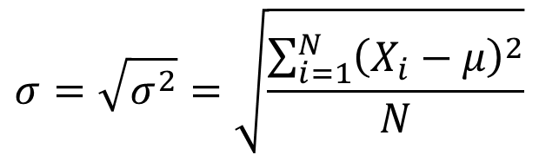
Standard Deviation
• Variance and Standard Deviation are POSITIVE numbers showing spread of data. The greater their value, the more spread the data is
• Standard Deviation has the same unit as data
The Population Standard Deviation is shown by $σ$ is the square root of the population variance:
$$σ=\sqrt{σ^{2}}=\sqrt{\frac{\sum_{i=1}^{N}{{\left(X_{i}−μ\right)}^{2}}}{N}}$$
The SAMPLE Standard Deviation is the square root of the SAMPLE variance.
$$s=\sqrt{s^{2}}=\sqrt{\frac{\sum_{i=1}^{n}{{\left(x_{i}−\overline{x}\right)}^{2}}}{n−1}}$$

Slide 9
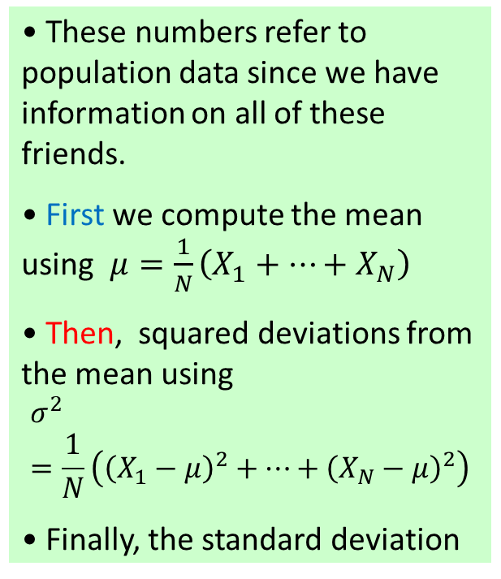
Example
• These numbers refer to population data since we have information on all of these friends.
• First we compute the mean using $μ=\frac{1}{N}\left(X_{1}+…+X_{N}\right)$
• Then, squared deviations from the mean using
$$σ^{2}=\frac{1}{N}\left({\left(X_{1}−μ\right)}^{2}+…+{\left(X_{N}−μ\right)}^{2}\right)$$
• Finally, the standard deviation
Find the variance and standard deviation of the following number of accidents a group of 5 friends had (N=5).
2 0 2 7 1
A quick approximation using range is 1.75 which is not bad
Notes:
These numbers refer to population data since we have information on all of these friends.
$$μ=\frac{1}{5}\left(2+0+2+7+1\right)=2.4$$
$$σ^{2}=\frac{1}{5}\left({\left(2−2.4\right)}^{2}+{\left(0−2.4\right)}^{2}+…+{\left(1−2.4\right)}^{2}\right)=\frac{1}{5}\left(0.16+5.76+…+1.96\right)=5.84$$
$$σ=\sqrt{7.3}=2.42$$

Slide 10
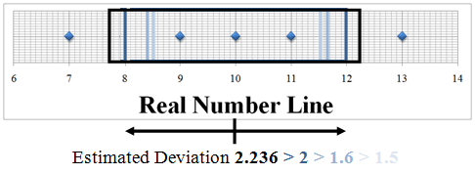
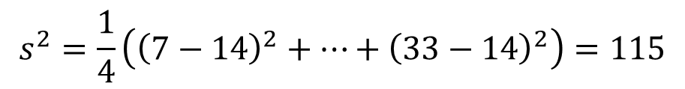
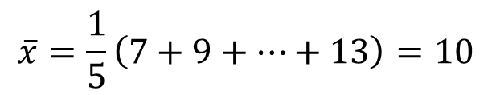
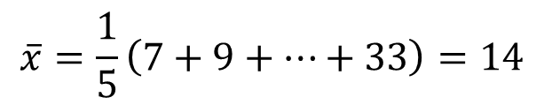

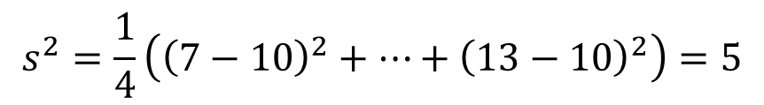

Example
$$\overline{x}=\frac{1}{5}\left(7+9+…+13\right)=10$$
$$s^{2}=\frac{1}{4}\left({\left(7−10\right)}^{2}+…+{\left(13−10\right)}^{2}\right)=5$$
Given the following sample data:
7, 9, 10, 11, 13
What is the standard deviation?
$$s=\sqrt{5}=2.24$$
$$\overline{x}=\frac{1}{5}\left(7+9+…+33\right)=14$$
What happens if we change 13 to 33?
7, 9, 10, 11, 33
$$s^{2}=\frac{1}{4}\left({\left(7−14\right)}^{2}+…+{\left(33−14\right)}^{2}\right)=115$$
$$s=\sqrt{115}=10.72$$

Slide 11
Using Frequency Tables
If we have frequency tables, remember that values in frequency show repeats for class marks.
1 | 7.45 | 6
2 | 8.85 | 15
3 | 10.25 | 16
4 | 11.65 | 9
5 | 13.05 | 4
Sum |  | 50
44.7
132.75
164
104.85
52.2
498.5
-2.52
-1.12
0.28
1.68
3.08
38.10
18.82
1.25
25.40
37.95
121.52

Slide 12
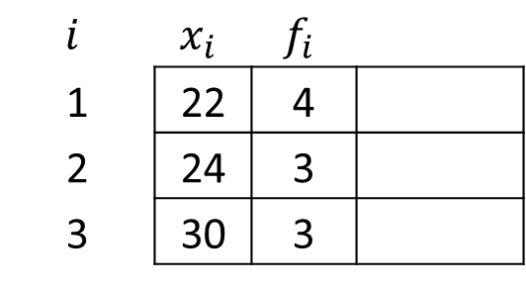
Question
$$i$$ | $$x_{i}$$ | $$f_{i}$$
1 | 22 | 4
2 | 24 | 3
3 | 30 | 3
Compute the standard deviation IF this is a frequency table for sample data.
Notes:
3.56

Slide 13

Coefficient of Variation (CV)
Ex. Heights and Weights of 40 men is recorded and some statistic are computed as table shows. Using the sample data compare the variation of the two measurements.
The coefficient of variation (CV) for a set of non-negative sample or population data, expressed as a percent, is a unit-less measure of spread computed as
CV enables us to compare spread for two datasets with different units of measure.
Observation 1 2 3 4 5
Data values 5 7 3 9 7
CV = ?
Notes:
CV = s / xbar = sqrt(5.2) / 6.2 = 0.368

Slide 14
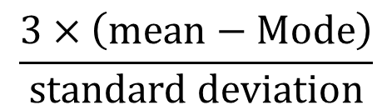
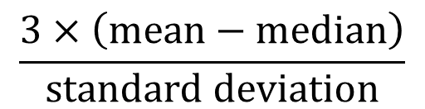
Skewness
• If the computed values is zero, the distribution is symmetric.
• If the computed values is positive, the distribution is skewed to right.
• If the computed values is negative, the distribution is skewed to left.
Skewness is a measure of asymmetry of a set of data. It can be computed using
$$\frac{3×\left(mean−Mode\right)}{standard deviation}$$
$$\frac{3×\left(mean−median\right)}{standard deviation}$$
Determine if the given dataset is skewed or not.
n = 14
Sum = 433
0 | 7
| 7 8 9
| 5 6 6 6
| 5 9
| 5 6 8
| 6

Slide 15
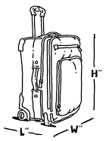
Exercise
The following numbers show a random sample of 13 airline carry-on luggage weights rounded to the nearest pound.
10 12 19 8 12 17 7 21 10 12 16 6 12
a) Compute all appropriate spread measures.
b) Compute skewness and decide on the shape of the distribution of the data.

Slide 16
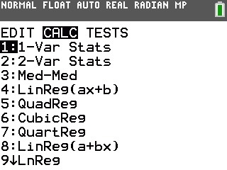
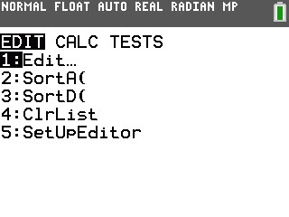
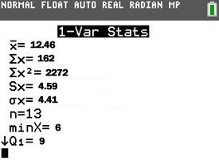
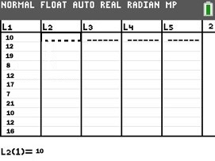
USING CALCULATOR
3. STAT > CALC
Select 1-Var Stats
L1
10
12
19
8
12
17
7
21
10
12
16
6
12
To compute ALL the central and spread measures.
1. STATS > EDIT
4. Assign Data
Hit OK
2. Enter Data
• Don’t enter anything for Freq.
• Pressing 2nd then 1 enters L1
2nd then 2 enters L2, etc.
Notes:
Sx is the sample standard deviation, you need to square it to get sample variance
σx is the population standard deviation, squaring it gives you population variance
You need to compute skewness manually, compute its sample value using xbar=12.46, m=12, M=12

Slide 17
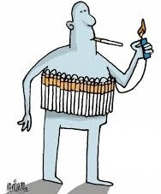
Practice Problems Part 5
1. The following table contains the nicotine content in milligrams (mg) per cigarette for 29 popular cigarette brands
a) Compute all the appropriate spread measures and compare their values.
b) Compute the skewness measure and comment on the shape of the distribution of data.
First compute them BY HAND, then use your CALCULATOR.
Notes:
Answers are provided in Ch2 Practice Problem Solutions

Slide 18
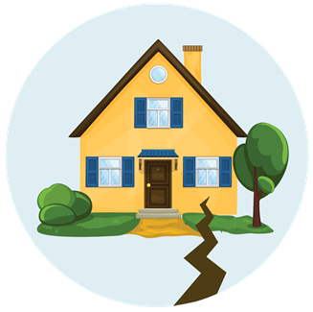
Practice Problems Part 5
2. The ages of females and males who died of sudden cardiac causes after 4:31 am on the day of the Northridge Earthquake are given below.
a) Compute all the appropriate spread measures and compare their values for males and females. Which data is more spread?
b) Compute the skewness for males and females data and comment on the shape of the distribution of data?
Female | 77 | 83 | 75 | 77 | 70 | 80 | 68 | 58 | 70 | 81 | 78 | 69 | 38
Male | 90 | 38 | 45 | 47 | 79 | 75 | 71 | 68 | 51 | 55 | 66 | 56 | 59 | 60 | 68 | 64 | 53 | 90
Notes:
Answers are provided in Ch2 Practice Problem Solutions

Slide 19
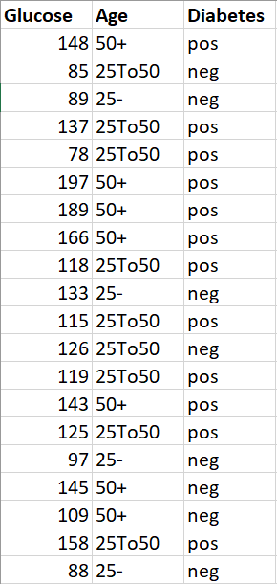
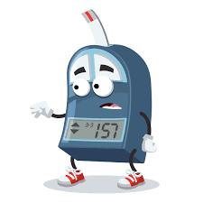
Practice Problems Part 5
3. The table shows information on Glucose level, Age group (25-, 25To50, 50+) and Diabetes status for a random sample of 20 patients.
a) Compute the all the appropriate spread measures for Glucose level on Positive and Negative diabetes status and compare their values.
b) Compute the skewness of Glucose for Positive and Negative diabetes status and comment on the shape of the distribution of data?
Notes:
Answers are provided in Ch2 Practice Problem Solutions

